Slide 1
Flow chart

Slide 2
Flow chart
Flowchart is a graphical or pictorial or diagrammatic representation of an algorithm.
Programmers often use it as a program-planning tool to solve a problem.
The process of drawing a flowchart for an algorithm is known as “flowcharting”.
It helps to clarify complex processes

Slide 3
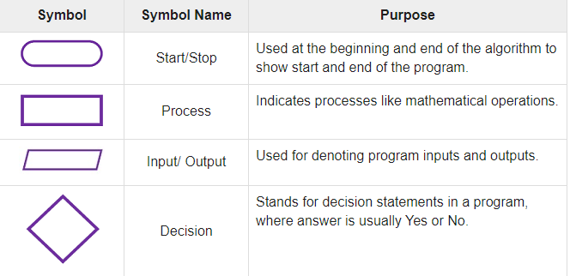
Flowchart Symbols

Slide 4
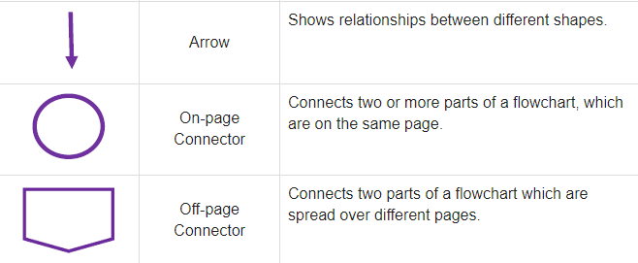

Slide 5
flowchart to calculate the average of two numbers.

Slide 6
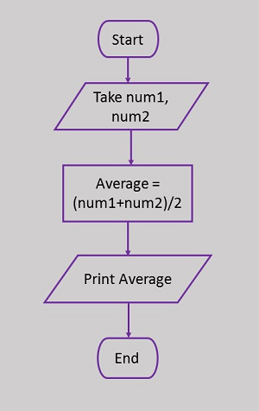

Slide 7
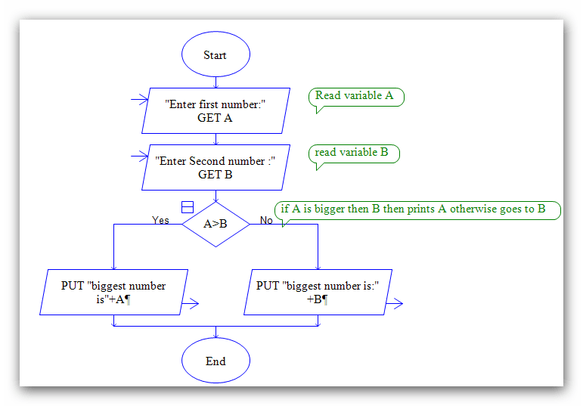

Slide 8
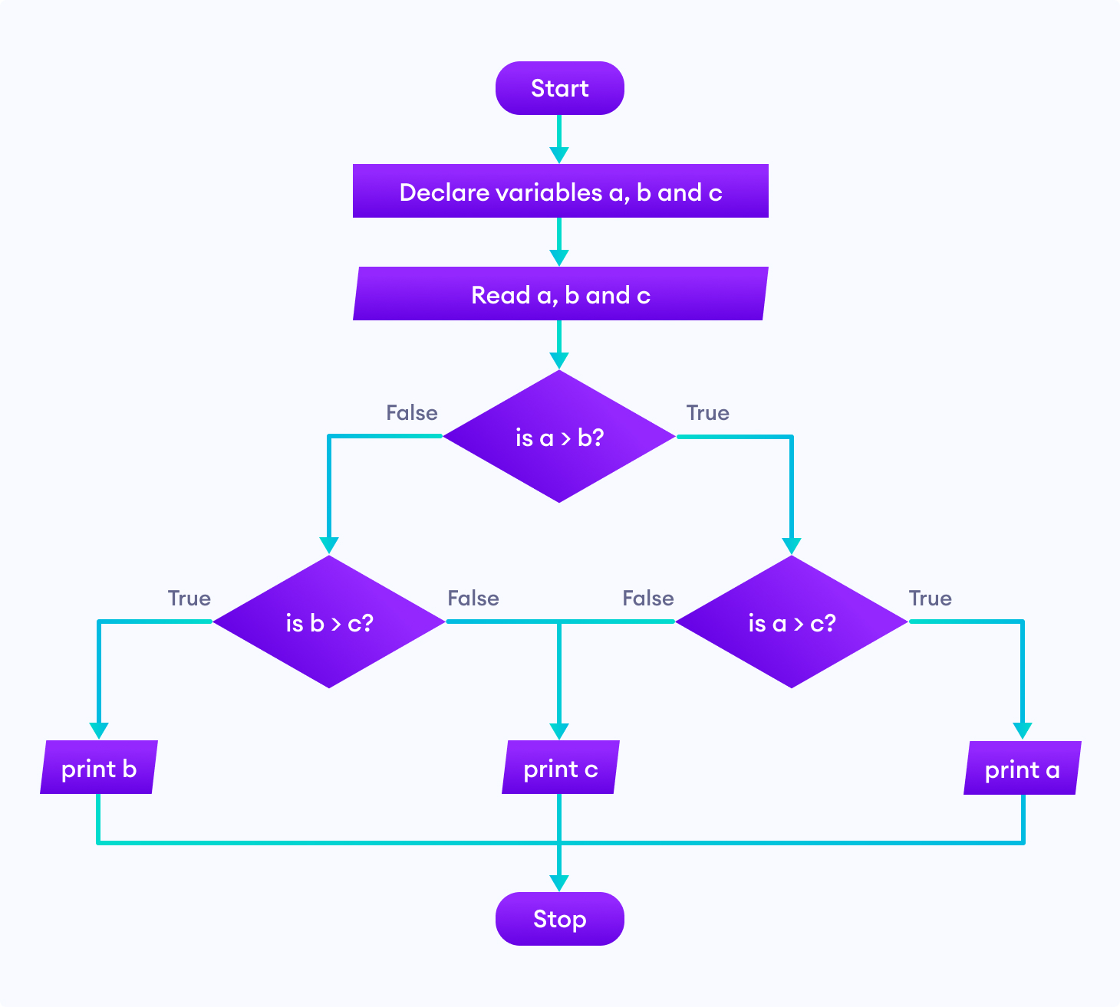

Slide 9
psedocode
Pseudocode is a simple way of writing programming code in English.
Pseudocode is not actual programming language.
It uses short phrases to write code for programs before you actually create it in a specific language.

Slide 10
.
example of pseudocode to create a program to add 2 numbers together and then display the result

Slide 11
Start Program Enter two numbers, A, B Add the numbers together Print Sum End Program

Slide 12
pseudocode to compute the area of a rectangle:
Get the length, l, and width, w Compute the area = l*w Display the area

Slide 13
Advantages of Pseudocode
Improves the readability of any approach.
Acts as a bridge between the program and the algorithm or flowchart

Slide 14
Disadvantages of Pseudocode
There are no proper format for writing the for pseudocode.
In Pseudocode their is no proper standard for writing the pseudocode.

Slide 15
C language
C is a general-purpose, high-level language that was originally developed by Dennis M. Ritchie at AT&TBell Labs in 1972.
C is a procedural programming language
C was invented to write an operating system called UNIX.

Slide 16
It can be defined by the following ways:
Mother language
System programming language
Procedure-oriented programming language
Structured programming language
Mid-level programming language

Slide 17
Easy to learn
Structured language
It produces efficient programs
It can handle low-level activities
It can be compiled on a variety of computer platforms

Slide 18
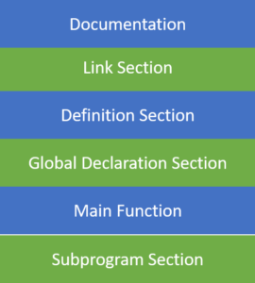
Structure of a c program

Slide 19
Documentation Section
In this section we can declare comments.
Comments are nothing but name of the c program.
We have two types of comments.
Line comments: used to comment single line statements.
Block comments: used to comment multi line statements.

Slide 20
Line comments
Ex: // this is a c program
// addition of two numbers

Slide 21
Block comments
/* this is my 1st program
Adding two numbers*/

Slide 22
Link Section
This part of the code is used to declare all the header files that will be used in the c program.
here we can use preprocessor directives to represent header files.
Each preprocessor directive starts with the symbol #.
#include<stdio.h>

Slide 23
We have different types of header files
All the header file have a ‘.h’ an extension

Slide 24
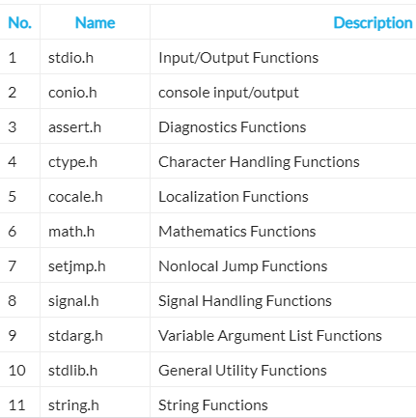

Slide 25
Definition Section
In this section, we define different constants. The keyword define is used in this part.
#define PI=3.14

Slide 26
Global Declaration Section
All the global variable used are declared in this part. The user-defined functions are also declared in this part of the code.
int a=7;

Slide 27
Main Function Section
Every C-programs needs to have the main function.
Each main function contains 2 parts.
A declaration part and an Execution part.
The declaration part is the part where all the variables are declared.

Slide 28
The execution part begins with the curly brackets and ends with the curly close bracket.
Both the declaration and execution part are inside the curly braces.

Slide 29
int main()
{
int a=10;
printf(" %d", a);
return 0;
}

Slide 30
Sub Program Section
All the user-defined functions are defined in this section of the program.
int add(int a, int b)
{
return a+b;
}

Slide 31
Example programs

Slide 32
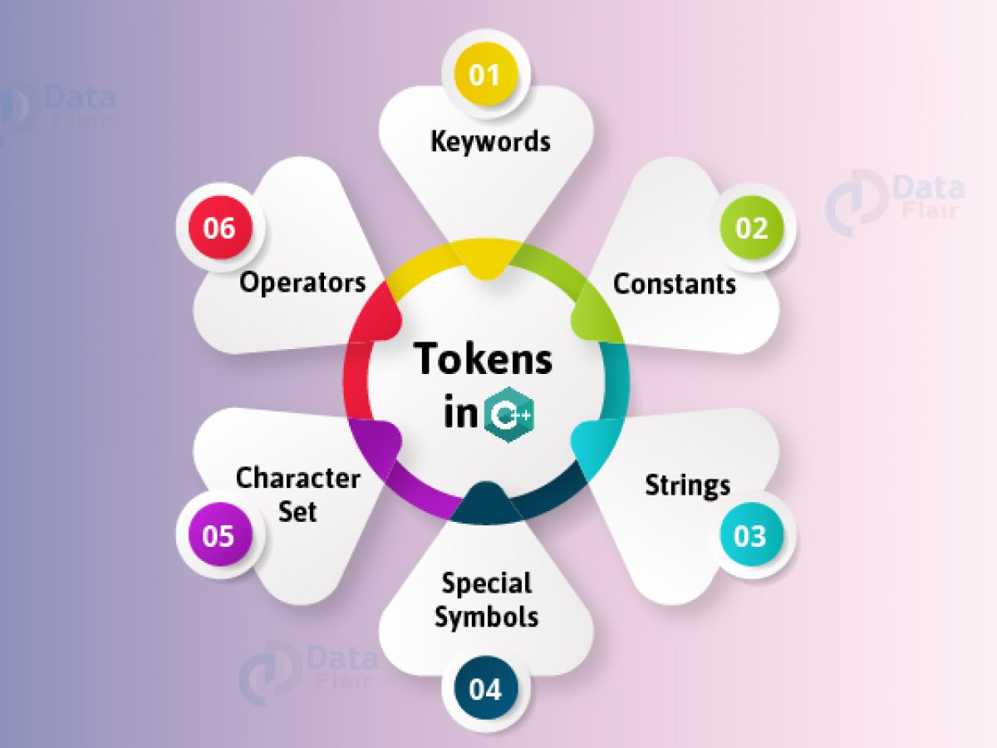
C tokens

Slide 33
keywords
A keyword is a predefined and reserved words.
You cannot use it as a variable name, constant name

Slide 34
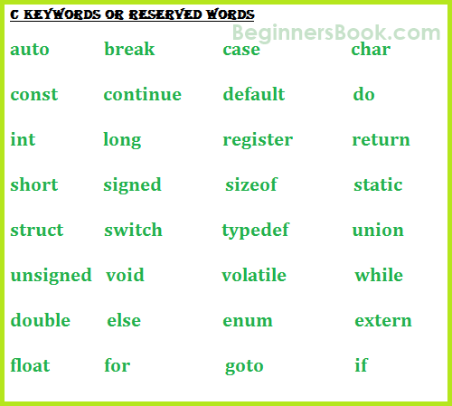

Slide 35
identifiers
"Identifiers" or "symbols" are the names you supply for variables, types, functions, and labels in your program.
An identifier can be composed of letters such as uppercase, lowercase letters, underscore, digits,

Slide 36
Rules for constructing C identifiers
The first character of an identifier should be either an alphabet or an underscore
It should not begin with any numerical digit.
In identifiers, both uppercase and lowercase letters are distinct.

Slide 37
Commas or blank spaces cannot be specified within an identifier.
Keywords cannot be represented as an identifier.
The length of the identifiers should not be more than 31 characters.
Identifiers should be written in such a way that it is meaningful, short, and easy to read.

Slide 38
Constants in c
Constant variable, does not change its value during the execution of a program.
A constant is a data value written by a programmer.
Constants may be belonging to any of the data type(int, float, char). There are 4 basic types of constants. They are

Slide 39
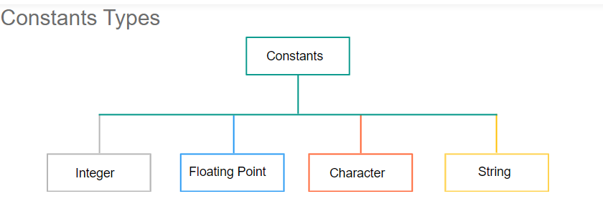

Slide 40
Operators in c
An operator is a symbol that specifies the mathematical, logical or relational operation to be performed.
C language supports different types of operators.

Slide 41
Integer Constants
An integer constants consists of sequence of Integer numbers from 0 to 9.
Decimal points, black spaces, commas cannot be included within an integer constants.
An Integer constants can either be positive or negative or zero.
The number without sign can be assumed as positive

Slide 42
Floating point constant
A floating point constant consist of integer part, decimal point and fractional part.
A floating point constant contains exponential field e or E followed by an integer.

Slide 43
Character Constants
A character constant is a single character enclosed within single quotes ' '.
A character constant also represented with a single digit or a single special character or white space enclosed within a single quotes.

Slide 44
String Constants
A string constant is a sequence of characters enclosed within double quotes " ".
The Characters may consists of letters, digits, escape sequences and spaces.

Slide 45
Arithmetic operators
C Increment and Decrement Operators
Relational operations
Equality operators
Logical operators
Unary operators
Conditional/Ternary operators
Bitwise operators
Assignment operators
Comma operators
Sizeof operators

Slide 46
Arithmetic operators
An arithmetic operator performs mathematical operations such as addition, subtraction, multiplication, division etc on numerical values .

Slide 47
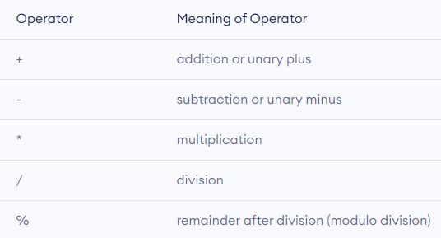

Slide 48
Example 1: Arithmetic Operators
// Working of arithmetic operators
#include <stdio.h>
int main()
{
int a = 9,b = 4, c;
c = a+b;
printf("a+b = %d \n",c);
c = a-b;
printf("a-b = %d \n",c);
c = a*b;
printf("a*b = %d \n",c);
c = a/b;
printf("a/b = %d \n",c);
c = a%b;
printf("Remainder when a divided by b = %d \n",c);
return 0;
}

Slide 49
Output
a+b = 13
a-b = 5
a*b = 36
a/b = 2
Remainder when a divided by b=1

Slide 50
C Increment and Decrement Operators
C programming has two operators increment ++ and decrement -- to change the value of an operand (constant or variable) by 1.
Increment ++ increases the value by 1 whereas decrement -- decreases the value by 1.

Slide 51
Example 2: Increment and Decrement Operators
// Working of increment and decrement operators
#include <stdio.h>
int main()
{
int a = 10, b = 100;
float c = 10.5, d = 100.5;
printf("++a = %d \n", ++a);
printf("--b = %d \n", --b);
printf("++c = %f \n", ++c);
printf("--d = %f \n", --d);
return 0;
}

Slide 52
Output
++a = 11
--b = 99
++c = 11.500000
--d = 99.500000

Slide 53
C Relational and Equality Operators
A relational operator checks the relationship between two operands.
If the relation is true, it returns 1; if the relation is false, it returns value 0.
Relational operators are used in decision making and loops.

Slide 54
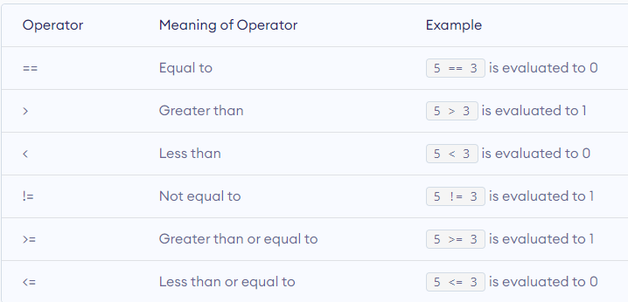

Slide 55
Example : Relational Operators
// Working of relational operators
#include <stdio.h>
int main()
{
int a = 5, b = 5, c = 10;
printf("%d == %d is %d \n", a, b, a == b);
printf("%d == %d is %d \n", a, c, a == c);
printf("%d > %d is %d \n", a, b, a > b);
printf("%d > %d is %d \n", a, c, a > c);
printf("%d < %d is %d \n", a, b, a < b);
printf("%d < %d is %d \n", a, c, a < c);
printf("%d != %d is %d \n", a, b, a != b);
printf("%d != %d is %d \n", a, c, a != c);
printf("%d >= %d is %d \n", a, b, a >= b);
printf("%d >= %d is %d \n", a, c, a >= c);
printf("%d <= %d is %d \n", a, b, a <= b);
printf("%d <= %d is %d \n", a, c, a <= c);
return 0;
}

Slide 56
Output
5 == 5 is 1
5 == 10 is 0
5 > 5 is 0
5 > 10 is 0
5 < 5 is 0
5 < 10 is 1
5 != 5 is 0
5 != 10 is 1
5 >= 5 is 1
5 >= 10 is 0
5 <= 5 is 1
5 <= 10 is 1

Slide 57
Logical operators
An expression containing logical operator returns either 0 or 1 depending upon whether expression results true or false.
Logical operators are commonly used in decision making in C programming.

Slide 58
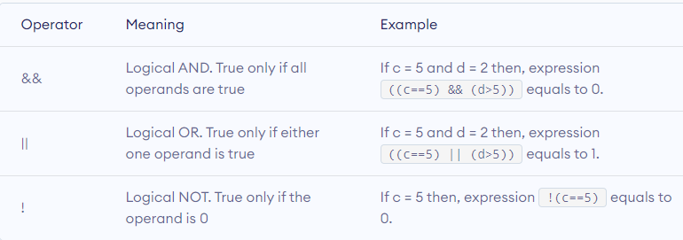

Slide 59
Example : Logical Operators
// Working of logical operators
#include <stdio.h>
int main()
{
int a = 5, b = 5, c = 10, result;
result = (a == b) && (c > b);
printf("(a == b) && (c > b) is %d \n", result);
result = (a == b) && (c < b);
printf("(a == b) && (c < b) is %d \n", result);
result = (a == b) || (c < b);
printf("(a == b) || (c < b) is %d \n", result);
result = (a != b) || (c < b);
printf("(a != b) || (c < b) is %d \n", result);
result = !(a != b); printf("!(a != b) is %d \n", result);
result = !(a == b); printf("!(a == b) is %d \n", result);
return 0;
}

Slide 60
Output
(a == b) && (c > b) is 1
(a == b) && (c < b) is 0
(a == b) || (c < b) is 1
(a != b) || (c < b) is 0 !(a != b) is 1
!(a == b) is 0

Slide 61
C Bitwise Operators
During computation, mathematical operations like: addition, subtraction, multiplication, division, etc are converted to bit-level which makes processing faster and saves power.
Bitwise operators are used in C programming to perform bit-level operations.

Slide 62
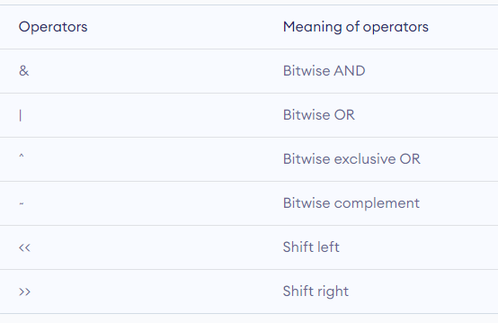

Slide 63
Switch case in c
allows us to execute multiple operations for the different possibles values .
Here, We can define various statements in the multiple cases for the different values of a single variable.

Slide 64
syntax
switch (expression) ​
{
case constant1:
// statements
break;
case constant2:
// statements
break; . . .
default:
// default statements
}

Slide 65
Rules for switch statement
1) The switch expression must be of an integer or character type.
2) The case value must be an integer or character constant.
3) The case value can be used only inside the switch statement.
4) The break statement in switch case is not must. It is optional.

Slide 66
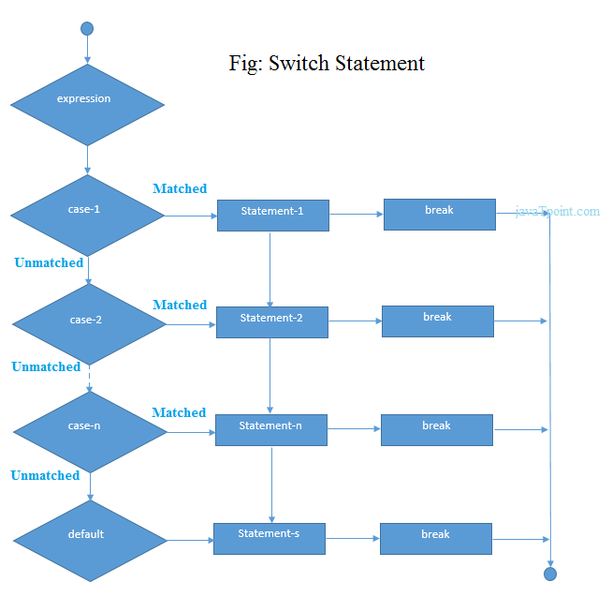

Slide 67
Ex program
#include<stdio.h>
int main(){
int number=0;
printf("enter a number:");
scanf("%d",&number);
switch(number){
case 10:
printf("number is equals to 10");
break;
case 50:
printf("number is equal to 50");
break;
case 100:
printf("number is equal to 100");
break;
default:
printf("number is not equal to 10, 50 or 100");
} return 0;
}

Slide 68
output
enter a number:4
number is not equal to 10, 50 or 100

Slide 69
Switch case example 2
#include <stdio.h>
int main()
{
int x = 10, y = 5;
switch(x>y && x+y>0)
{
case 1:
printf("hi");
break;
case 0:
printf("bye");
break;
default:
printf(" Hello bye ");
}
}

Slide 70
Output:
hi

Slide 71
Switch without break: fallthrough case
#include<stdio.h>
int main(){
int number=0;
printf("enter a number:");
scanf("%d",&number);
switch(number){
case 10:
printf("number is equal to 10\n");
case 50:
printf("number is equal to 50\n");
case 100:
printf("number is equal to 100\n");
default:
printf("number is not equal to 10, 50 or 100");
}
return 0;
}

Slide 72
output
enter a number:10
number is equal to 10
number is equal to 50
number is equal to 100
number is not equal to 10, 50 or 100

Slide 73
Looping statements
The looping can be defined as repeating the same process multiple times until a specific condition satisfies.
Loops are of 2 types:
entry-controlled loop and
exit-controlled loop.

Slide 74
Entry Control Loop the test condition is checked first and if that condition is true then the block of the statement will be executed.
Ex: while loop, for loop
While in Exit control loop first executes the body of the loop and checks condition at last.
Ex: do-while

Slide 75
while loop in C
It is also called a pre-tested loop.
The block of statements is executed in the while loop until the condition specified in the while loop is satisfied.
Syntax:
initialization
while(condition){
//code to be executed (incrementation)
}

Slide 76
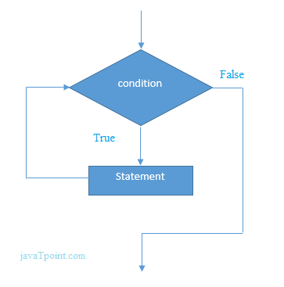

Slide 77
example
#include<stdio.h>
int main(){
int i=1;
while(i<=10){
printf("%d \n",i);
i++;
}
return 0;
}

Slide 78
output
1
2
3
4
5
6
7
8
9
10

Slide 79
#include<stdio.h>
int main(){
int i=1,number=0,b=9;
printf("Enter a number: ");
scanf("%d",&number);
while(i<=10){
printf("%d \n",(number*i));
i++;
}
return 0;
}

Slide 80
output
Enter a number: 50
50
100
150
200
250
300
350
400
450
500

Slide 81
#include<stdio.h>
void main ()
{
int j = 1;
while(j+=2,j<=10)
{
printf("%d ",j);
}
printf("%d",j);
}

Slide 82
output
Output
3 5 7 9 11

Slide 83
For loop in c
The for loop is used in the case where we need to execute some part of the code until the given condition is satisfied.
The for loop is also called as a per-tested loop.

Slide 84
syntax
for(initialization;condition;incr/decr)
{
//code to be executed
}

Slide 85
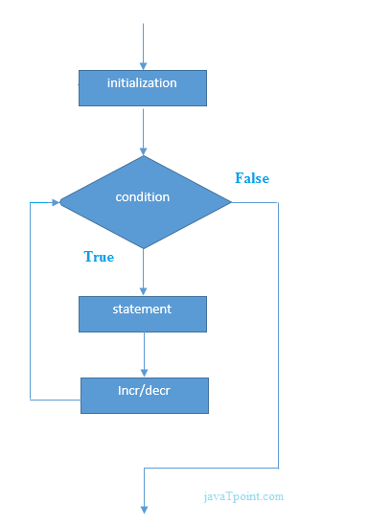

Slide 86
ex
#include<stdio.h>
int main(){
int i=0;
for(i=1;i<=10;i++){
printf("%d \n",i);
}
return 0;
}

Slide 87
Output
1 2 3 4 5 6 7 8 9 10

Slide 88
Print table for the given number using C for loop
#include<stdio.h>
int main(){
int i=1,number=0;
printf("Enter a number: ");
scanf("%d",&number);
for(i=1;i<=10;i++){
printf("%d \n",(number*i));
}
return 0;
}

Slide 89
Output
Enter a number: 2 2 4 6 8 10 12 14 16 18 20

Slide 90
#include <stdio.h>
int main()
{
int a,b,c;
for(a=0,b=12,c=23;a<2;a++)
{
printf("%d ",a+b+c);
}
}

Slide 91
Output
35 36

Slide 92
do while loop in C
The do while loop is a post tested loop. Using the do-while loop, we can repeat the execution of several parts of the statements.
Syntax
initialization
do{
//code to be executed (incr/decr)
}while(condition);

Slide 93
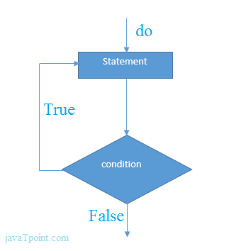

Slide 94
#include<stdio.h>
int main(){
int i=1;
do{
printf("%d \n",i);
i++;
}while(i<=10);
return 0;
}

Slide 95
Output
1 2 3 4 5 6 7 8 9 10

Slide 96
Types of arrays
Single Dimensional Array / One Dimensional Array
Two Dimensional Array
Multi Dimensional Array

Slide 97
Single Dimensional Array / One Dimensional Array
In c programming language, single dimensional arrays are used to store list of values of same datatype.
In other words, single dimensional arrays are used to store a row of values.
In single dimensional array, data is stored in linear form.
Single dimensional arrays are also called as one-dimensional arrays, Linear Arrays or simply 1-D Arrays.

Slide 98
Declaration of Single Dimensional Array
datatype arrayName [ size ] ;
Example Code
int rollNumbers [60] ;

Slide 99
Initialization of Single Dimensional Array
datatype arrayName [ size ] = {value1, value2, ...} ;
Example Code
int marks [6] = { 89, 90, 76, 78, 98, 86 } ;

Slide 100
atatype arrayName [ ] = {value1, value2, ...} ;
The array must be initialized if it is created without specifying any size. In this case, the size of the array is decided based on the number of values initialized.
Example Code
int marks [] = { 89, 90, 76, 78, 98, 86 } ;

Slide 101
Accessing Elements of Single Dimensional Array
arrayName [ indexValue ]
Example Code
marks [2] = 99 ;

Slide 102
Two Dimensional Array
a list of one-dimensional arrays.
To declare a two-dimensional integer array of size [x][y], you would write something as follows −
datatype array_ name [rowsize] [column size];
For example int a[5] [5];

Slide 103
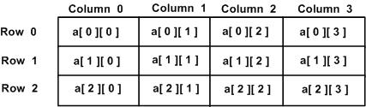

Slide 104
Initializing Two-Dimensional Arrays
int a[3][4] =
{ {0, 1, 2, 3} , {4, 5, 6, 7} , {8, 9, 10, 11}

Slide 105
Example program
#include<stdio.h>
main ( )
{
int a[3][3] = {10,20,30,40,50,60,70,80,90};
int i,j;
printf ("elements of the array are");
for ( i=0; i<3; i++)
{
for (j=0;j<3; j++)
{
printf("%d \t", a[i] [j]);
}
printf("\n");
}
}

Slide 106
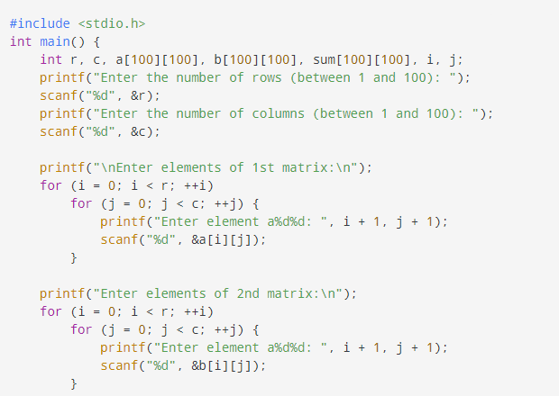
Program to Add Two Matrices

Slide 107
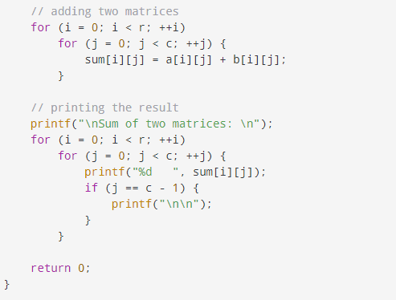

Slide 108
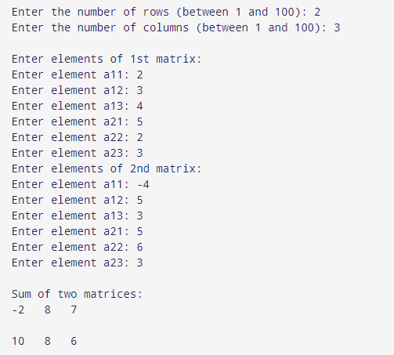

Slide 109
Matrix multiplication
In matrix multiplication first matrix one row element is multiplied by second matrix all column elements.
To multiply two matrices, the number of columns of the first matrix should be equal to the number of rows of the second matrix.

Slide 110
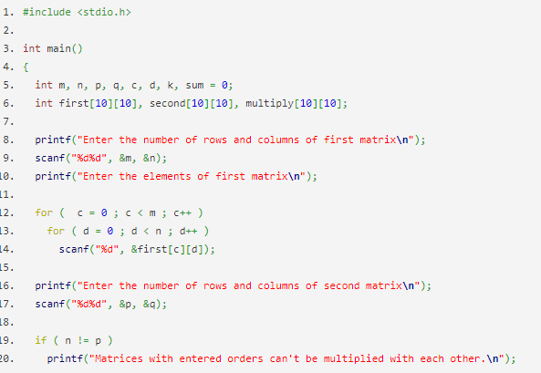

Slide 111
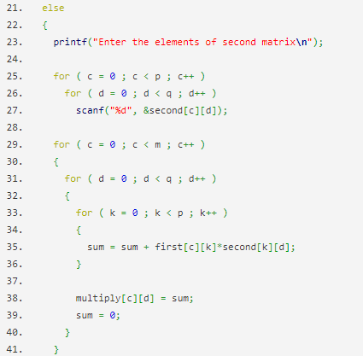

Slide 112
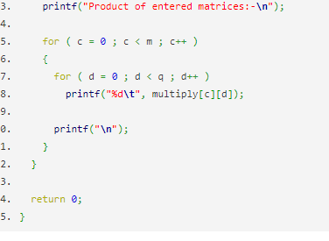

Slide 113
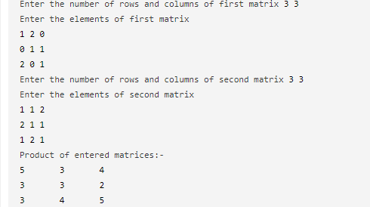

Slide 114
C Multidimensional Arrays
In C programming, you can create an array of arrays. These arrays are known as multidimensional arrays.
A multi-dimensional array is an array that has more than one dimension.
The simplest multi-dimensional array is the 2D array

Slide 115
Declaration of 3-d array
datatype arrayName [ size ] [ size ] [ size ] ;
Int y[2][4][3];

Slide 116
Initializing a multidimensional array
int test[2][3][4] =
{ {{3, 4, 2, 3}, {0, -3, 9, 11},
{23, 12, 23, 2}},
{{13, 4, 56, 3}, {5, 9, 3, 5},
{3, 1, 4, 9}}};

Slide 117
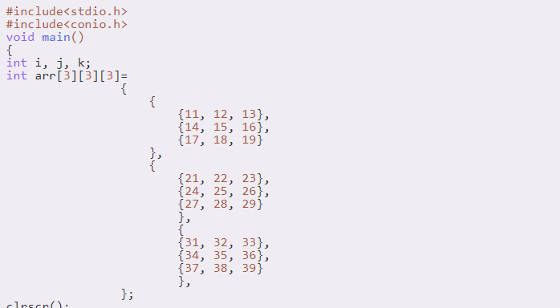
Example program

Slide 118
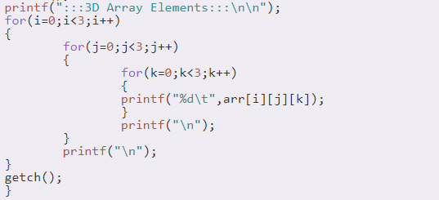

Slide 119
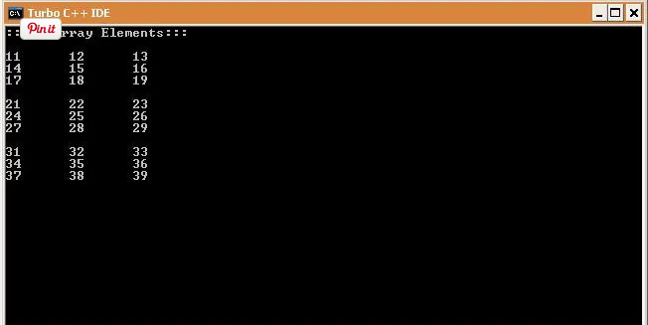

Slide 120
Unit-3 strings
The string can be defined as the one-dimensional array of characters terminated by a null ('\0').
The character array or the string is used to manipulate text such as word or sentences.
Each character in the array occupies one byte of memory, and the last character must always be 0.

Slide 121
There are two ways to declare a string in c language.
By char array
By string literal

Slide 122
Declaration of char array
Let's see the example of declaring string by char array in C language.
char ch[10]={‘a', ’d', ’i', ’t', ’y', ’a', '\0'};
char ch[]=“aditya";

Slide 123
The '%s' is used as a format specifier for the string in c language.
#include<stdio.h>
#include <string.h>
int main(){
char ch[11]={‘a', ’d', ’i', ’t', ’y', ’a', '\0'};
char ch2[11]=“programming";
printf("Char Array Value is: %s\n", ch);
printf("String Literal Value is: %s\n", ch2);
return 0;
}

Slide 124
read a string
#include <stdio.h>
int main()
{
char name[20];
printf("Enter name: ");
scanf("%s", name);
printf("Your name is %s.", name);
return 0;
}

Slide 125
Output
Enter name: Dennis Ritchie
Your name is Dennis.
Even though Dennis Ritchie was entered in the above program, only "Dennis" was stored in the name string. It's because there was a space after Dennis.

Slide 126
How to read a line of text?
You can use the fgets() function to read a line of string. And, you can use puts() to display the string.

Slide 127
#include <stdio.h>
int main()
{
char name[30];
printf("Enter name: ");
fgets(name, sizeof(name), stdin); // read string printf("Name: ");
puts(name); // display string return 0; }

Slide 128
Output
Enter name: Tom Hanks Name: Tom Hanks

Slide 129
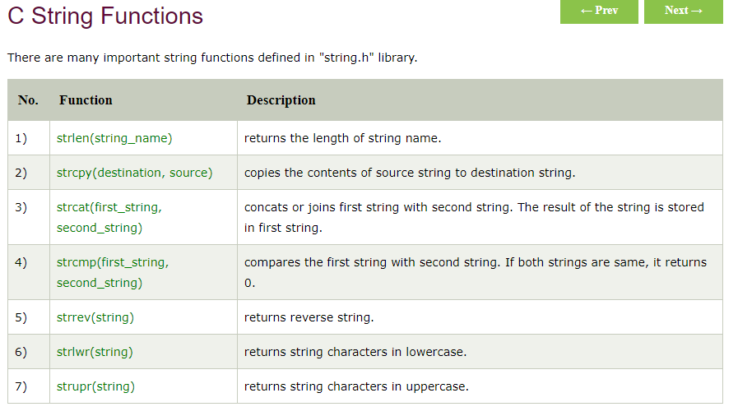

Slide 130
There are three aspects of a C function.
Function declaration A function must be declared globally in a c program to tell the compiler about the function name, function parameters, and return type.
Syntax
return_type function_name (argument list);

Slide 131
functions
Function is a self contained block of statements which performs a particular task.
In c, we can divide a large program into the basic building blocks known as function.
The function contains the set of programming statements enclosed by {}.

Slide 132
Advantage of functions in C
Reusability
modularity
we can avoid rewriting same logic/code again and again in a program.
we can avoid rewriting same logic/code again and again in a program.

Slide 133
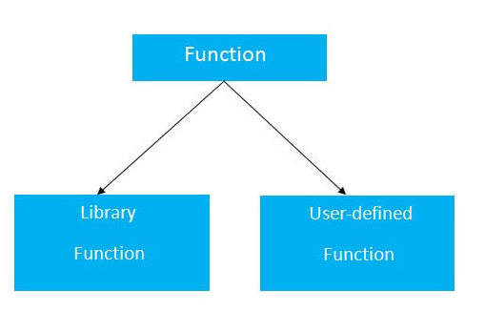
Types of Functions

Slide 134
Function call
Function can be called from anywhere in the program.
The parameter list must not differ in function calling and function declaration.
We must pass the same number of functions as it is declared in the function declaration.
Syntax
function_name (argument_list)

Slide 135
Function definition
It contains the actual statements which are to be executed.
It is the most important aspect to which the control comes when the function is called.
Here, we must notice that only one value can be returned from the function.
Syntax
return_type function_name (argument list)
{
function body;
}

Slide 136
Categories of functions/ Types of Functions in C Programming
There can be 4 different types of user-defined functions, they are:
Function with no arguments and no return value
Function with no arguments and a return value
Function with arguments and no return value
Function with arguments and a return value

Slide 137
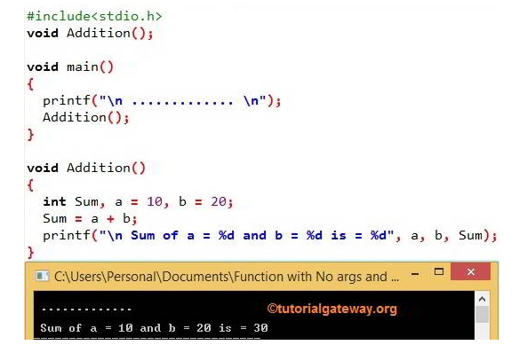
Function with no arguments and no return value

Slide 138
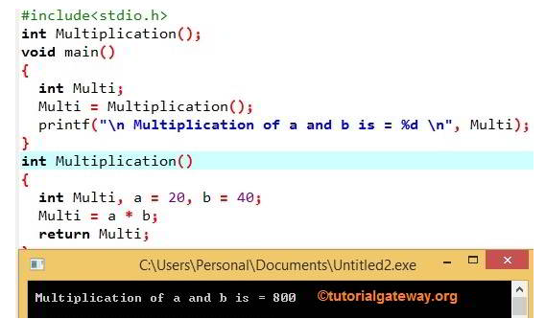
C Function with no argument and with Return value

Slide 139
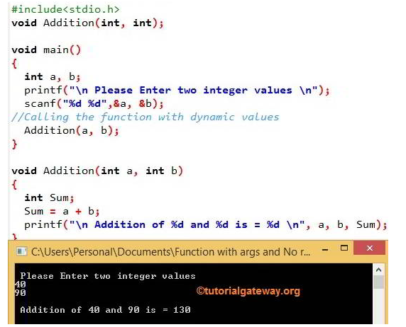
C Function with argument and No Return value

Slide 140
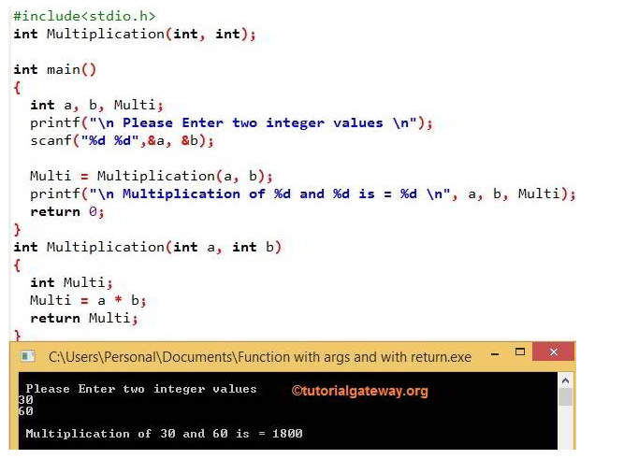
C Function with argument and Return value

Slide 141
Actual and formal parameters
Actual parameters: The parameters that appear in function calls.
Formal parameters: The parameters that appear in function declarations.

Slide 142
Example
#include <stdio.h>
int sum(int a, int b)
{
int c=a+b;
return c;
}
int main( )
{
int var1 =10;
int var2 = 20;
int var3 = sum(var1, var2);
printf("%d", var3);
return 0;
}

Slide 143
n the above example variable a and b are the formal parameters (or formal arguments).
Variable var1 and var2 are the actual arguments (or actual parameters).
The actual parameters can also be the values. Like sum(10, 20), here 10 and 20 are actual parameters.

Slide 144
Types of Function calls in C Parameter Passing Techniques in C
Call by Value
Call by Reference

Slide 145
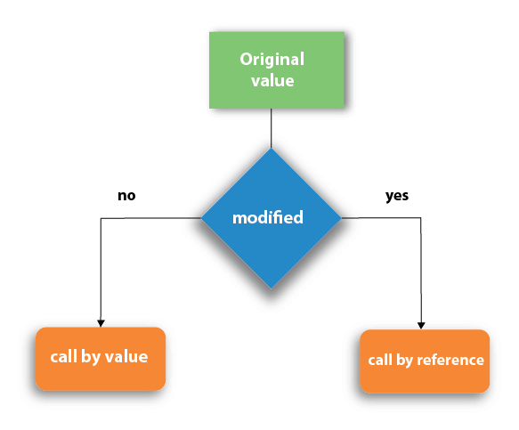

Slide 146
Call by Value
In call by value method, the value of the actual parameters is copied into the formal parameters.
In call by value method, we can not modify the value of the actual parameter by the formal parameter.
In call by value, different memory is allocated for actual and formal parameters

Slide 147
Example of Function call by Value
#include <stdio.h>
int increment(int var) {
var = var+1; return var;
}
int main()
{
int num1=20;
int num2 = increment(num1);
printf("num1 value is: %d", num1);
printf("\nnum2 value is: %d", num2);
return 0;
}

Slide 148
Output:
Num1 value is: 20
num2 value is: 21
We passed the variable num1 while calling the method, but since we are calling the function using call by value method, only the value of num1 is copied to the formal parameter var. Thus change made to the var doesn’t reflect in the num1.

Slide 149
Example 2: Swapping numbers using Function Call by Value

Slide 150
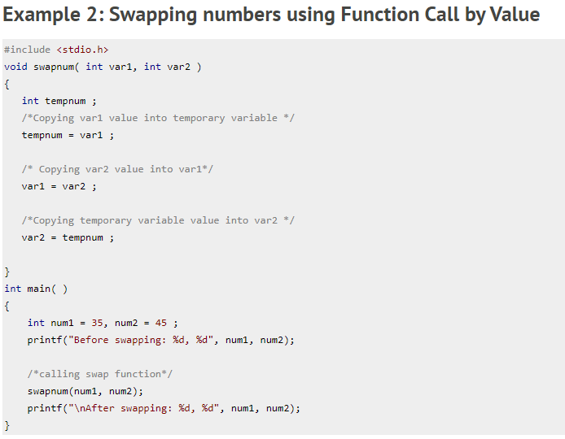

Slide 151
Output:
Before swapping: 35, 45
After swapping: 35, 45

Slide 152
call by Reference
When we call a function by passing the addresses of actual parameters then this way of calling the function is known as call by reference.
In call by reference, the operation performed on formal parameters, affects the value of actual parameters because all the operations performed on the value stored in the address of actual parameters.

Slide 153
example
#include <stdio.h>
void increment(int *var)
{
*var = *var+1;
}
int main()
{
int num=20;
increment(&num);
printf("Value of num is: %d", num);
return 0;
}

Slide 154
Output:
Value of num is: 21

Slide 155
example2

Slide 156
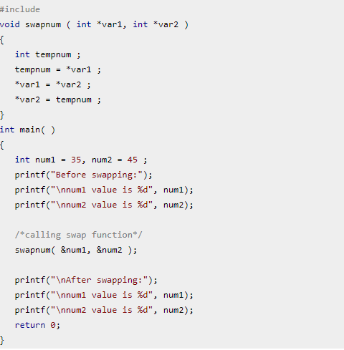

Slide 157
Output:
Before swapping:
num1 value is 35
num2 value is 45
After swapping:
num1 value is 45
num2 value is 35

Slide 158
Arrays as function arguments
As we know that the array_name contains the address of the first element.
Here, we must notice that we need to pass only the name of the array in the function which is intended to accept an array.
The array defined as the formal parameter will automatically refer to the array specified by the array name defined as an actual parameter.

Slide 159
There are 3 ways to declare the function which is intended to receive an array as an argument.
First way:
return_type function(type arrayname[])
Declaring blank subscript notation [] is the widely used technique.

Slide 160
Second way:
return_type function(type arrayname[SIZE])
Optionally, we can define size in subscript notation [].
Third way:
return_type function(type *arrayname)
You can also use the concept of a pointer.

Slide 161
C function to sort the array
Bubble sort

Slide 162
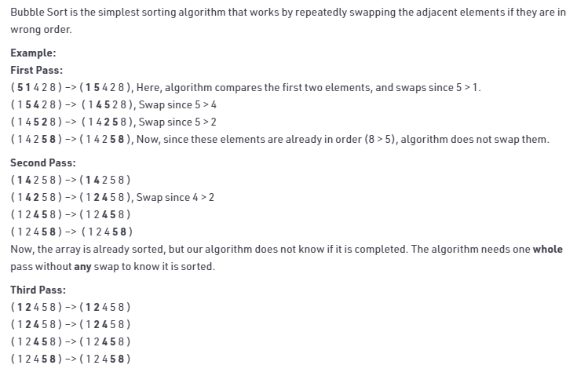

Slide 163
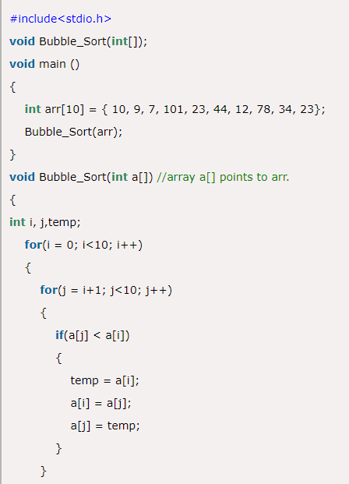

Slide 164
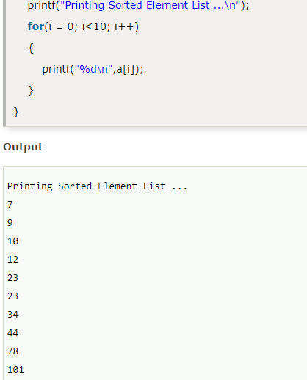

Slide 165
Scope of variables
Scope refers to the visibility of variables.
In C programming, variable declared within a function is different from a variable declared outside of a function.
The variable can be declared in three places. These are:

Slide 166
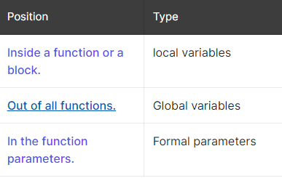

Slide 167
Table of Contents
# Local Variables
# Local Scope or Block Scope
# Global Variables
# Global Scope
# Global Variable Initialization

Slide 168
Local Variables
Variables that are declared within the function block and can be used only within the function is called local variables.

Slide 169
Local Scope or Block Scope
A local scope or block is collective program statements put in and declared within a function or block

Slide 170
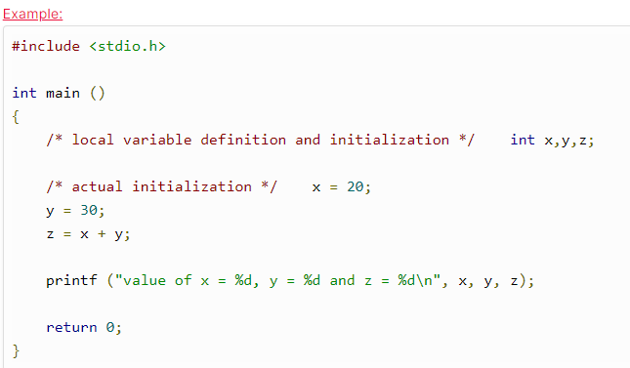

Slide 171
Global variables
Variables that are declared outside of a function block and can be accessed inside the function is called global variables.

Slide 172
Global Scope
Global variables are defined outside a function or any specific block, in most of the case, on the top of the C program.

Slide 173
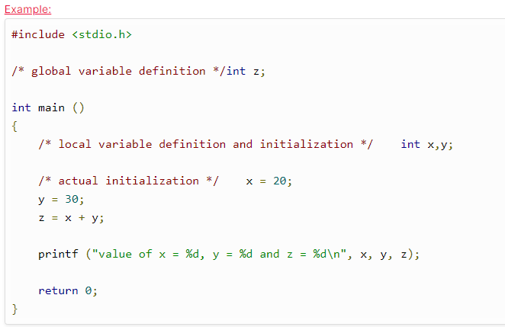

Slide 174
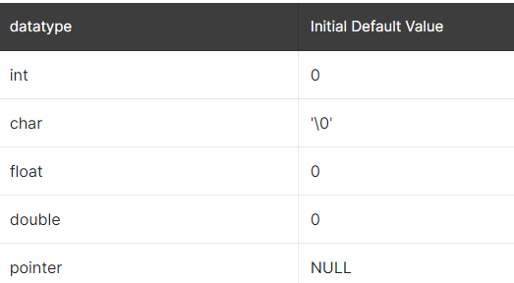
# Global Variable Initialization

Slide 175
variable storage classes in c
Storage classes in C are used to determine the lifetime, visibility, memory location, and initial value of a variable. There are four types of storage classes in C
Automatic
External
Static
Register

Slide 176
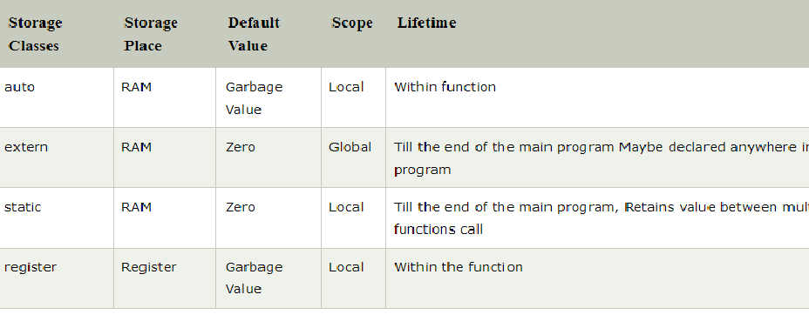

Slide 177
Automatic
Automatic variables are allocated memory automatically at runtime.
The visibility of the automatic variables is limited to the block in which they are defined.
The keyword used for defining automatic variables is auto.
Every local variable is automatic in C by default.

Slide 178
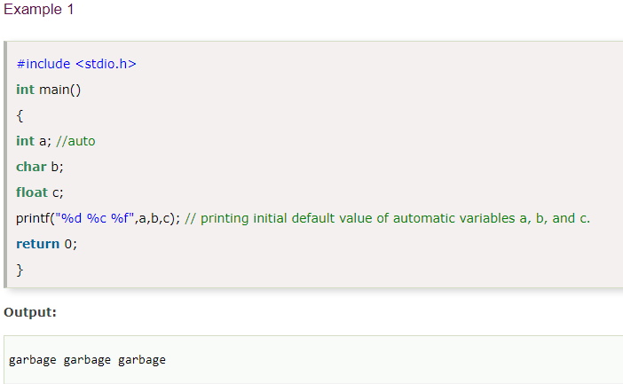

Slide 179
Static
The variables defined as static specifier can hold their value between the multiple function calls.
Static local variables are visible only to the function or the block in which they are defined.
The keyword used to define static variable is static.

Slide 180
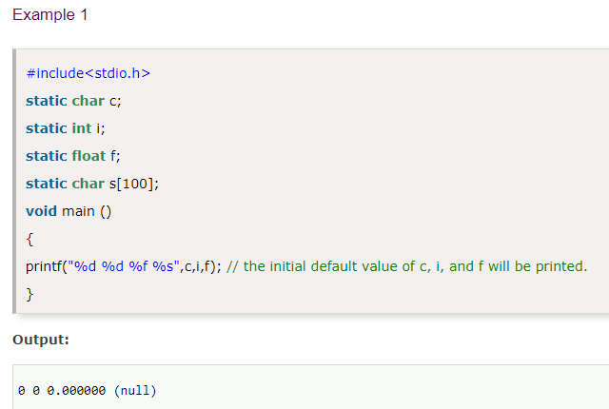

Slide 181
Register
The variables defined as the register is allocated the memory into the CPU registers depending upon the size of the memory remaining in the CPU.
We can not dereference the register variables, i.e., we can not use &operator for the register variable.
We can store pointers into the register, i.e., a register can store the address of a variable.
The register keyword is used for the variable which should be stored in the CPU register.

Slide 182
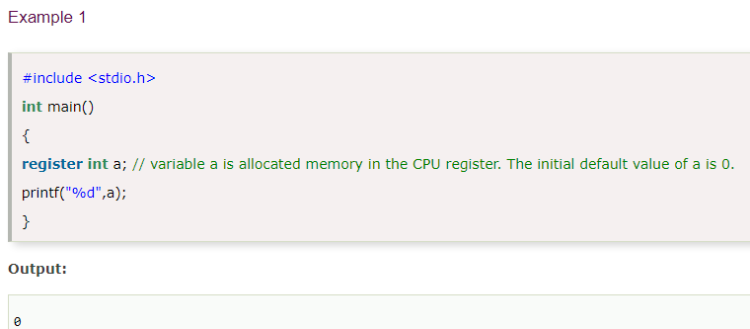

Slide 183
External
The external storage class is used to tell the compiler that the variable defined as extern is declared with an external linkage elsewhere in the program.
We can only initialize the extern variable globally,

Slide 184
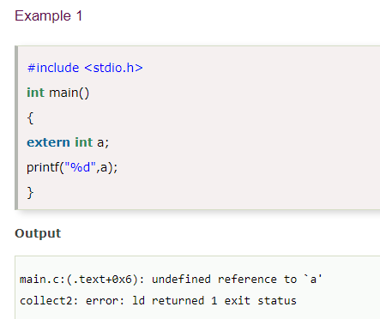

Slide 185


Slide 186
Recursion in C
The process in which a function calls itself directly or indirectly is called recursion and the corresponding function is called as recursive function.
recursion may be applied to sorting, searching, and traversal problems.

Slide 187
void recurse() { recurse(); /* Function calls itself */ } int main() { recurse(); /* Sets off the recursion */ return 0; }

Slide 188
Advantages of recursion
Recursion solves the problem in most general way.
Recursive function is small, simple and more reliable.
Recursion is used to solve the more complex problems.

Slide 189

recursion is used to calculate the factorial of a number.

Slide 190


Slide 191


Slide 192


Slide 193



Slide 194

Fibonacci Series Using Recursion

Slide 195


Slide 196
Types of Recursion
Recursive functions can be classified on the basis of : a.) If the functions call itself directly or indirectly – Direct / Indirect
b.) If an operation is pending at each recursive call – Tail Recursive/ Not
c.) based on the structure of the function calling pattern – Linear / Tree

Slide 197
Direct Recursion:
If a function explicitly calls itself it is called directly recursive.
When the method invokes itself it is direct.
int testfunc(int num) {
if (num == 0)
return 0;
Else
return (testfunc(num - 1));
}

Slide 198
Indirect Recursion
This occurs when the function invokes other method which again causes the original function to be called again.
int testfunc1(int num) {
if (num == 0)
return 0;
Else
return (testfunc2(num - 1));
}
int testfunc2(int num2)
{
return testfunc1(num2 - 1);
}

Slide 199
Tail / Bottom Recursion
It is a primitive recursion in which the recursive call is present as the last thing in the function.
int fact(int n)
{
if (n == 1)
return 1;
else
return (n * fact(n - 1));
}

Slide 200
Unit-4 pointers
A pointer is a variable that stores the address of another variable. i.e., direct address of the memory location.
For example, an integer variable holds (or you can say stores) an integer value, however an integer pointer holds the address of a integer variable.
int n = 10;
int* p = &n; // Variable p of type pointer is pointing to
the address of the variable n of type integer.

Slide 201
Advantage of pointer
1)Pointer reduces the code and improves the performance, it is used to retrieving strings, trees, etc. and used with arrays, structures, and functions.
2) We can return multiple values from a function using the pointer.
3) It makes you able to access any memory location in the computer's memory.
It allows C language to support Dynamic Memory management.

Slide 202
Declaring a pointer
The pointer in c language can be declared using * (asterisk symbol).
int *a;//pointer to int
char *c;//pointer to char
An example of using pointers to print the address and value is given below.

Slide 203
Initialization of C Pointer variable
Pointer Initialization is the process of assigning address of a variable to a pointer variable.
In C language address operator & is used to determine the address of a variable.

Slide 204


Slide 205

Pointer Example

Slide 206
example
#include<stdio.h>
void main()
{
int a = 10;
int *ptr; //pointer declaration
ptr = &a; //pointer initialization
}

Slide 207
Pointer variable always point to variables of same datatype.
#include<stdio.h>
void main()
{
float a;
int *ptr;
ptr = &a; // ERROR, type mismatch
}

Slide 208


Slide 209

pointer expression and address arithmetic in c

Slide 210

Arithmetic Operators We can perform arithmetic operations to pointer variables using arithmetic operators.

Slide 211


Slide 212


Slide 213

example

Slide 214


Slide 215


Slide 216


Slide 217


Slide 218


Slide 219


Slide 220


Slide 221


Slide 222


Slide 223


Slide 224
Address arithmetic
Address arithmetic is a method of calculating the address of an object with the help of arithmetic operations on pointers .
Pointer arithmetic cannot be performed on void pointers because the void type has no size.
All types of artihmetic operations are not possible in pointers.

Slide 225


Slide 226
NULL pointer in C
A null pointer is a pointer which points nothing.
A Null Pointer is a pointer that does not point to any memory location.
The null pointer basically stores the Null value while void is the type of the pointer.

Slide 227


Slide 228
Generic pointer
void pointer in c is known as generic pointer. Literal meaning of generic pointer is a pointer which can point type of data. Example:
void *ptr;
Here ptr is generic pointer.

Slide 229
Important points about generic pointer in c?
1. We cannot dereference generic pointer. #include<stdio.h>
#include <malloc.h>
int main(){
void *ptr;
printf("%d",*ptr); return 0;
}
Output: Compiler error

Slide 230
2. We can find the size of generic pointer using sizeof operator.
#include <string.h> #include<stdio.h>
int main(){
void *ptr;
printf("%d",sizeof(ptr)); return 0;
}
Output: 2

Slide 231

Pointer to arrays

Slide 232


Slide 233


Slide 234


Slide 235
Pointers to strings
A String is a sequence of characters stored in an array.
A string always ends with null ('\0') character.
Simply a group of characters forms a string and a group of strings form a sentence.
Creating a string
char str[6] = "Hello";

Slide 236


Slide 237
Creating a pointer for the string
The variable name of the string str holds the address of the first element of the array i.e., it points at the starting memory address

Slide 238


Slide 239
#include <stdio.h>
int main()
{
char *cities[] = {"Iran", "Iraq"};
int i;
for(i = 0; i < 2; i++)
printf("%s\n", cities[i]);
return 0;
}
Output:
Iran
Iraq

Slide 240
C - Pointer to Pointer (Double Pointer)
a pointer is used to store the address of a variable in C.
Pointer reduces the access time of a variable.
However, In C, we can also define a pointer to store the address of another pointer.
Such pointer is known as a double pointer (pointer to pointer).
The first pointer is used to store the address of a variable whereas the second pointer is used to store the address of the first pointer.

Slide 241


Slide 242


Slide 243
Dynamic memory allocation in C
The concept of dynamic memory allocation in c language enables the C programmer to allocate memory at runtime.
Dynamic memory allocation in c language is possible by 4 functions of stdlib.h header file.
malloc()
calloc()
realloc()
free()

Slide 244


Slide 245
malloc() function in C
The malloc() function allocates single block of requested memory.
It doesn't initialize memory at execution time, so it has garbage value initially.
It returns NULL if memory is not sufficient.
The syntax of malloc() function is given below:
ptr=(cast-type*)malloc(byte-size)

Slide 246


Slide 247
Output
Enter elements of array: 3
Enter elements of array:10
10
10
Sum=30

Slide 248
realloc() function in C
If memory is not sufficient for malloc() or calloc(), you can reallocate the memory by realloc() function. In short, it changes the memory size.
Let's see the syntax of realloc() function.
ptr=realloc(ptr, new-size) ;

Slide 249


Slide 250
Output
Enter elements of array: 3
Enter elements of array:10
10
10
Sum=30

Slide 251
calloc() function in C
he calloc() function allocates multiple block of requested memory.
It initially initialize all bytes to zero.
It returns NULL if memory is not sufficient.
The syntax of calloc() function is given below:
ptr=(cast-type*)calloc(number, byte-size)

Slide 252
free() function in C
The memory occupied by malloc() or calloc() functions must be released by calling free() function. Otherwise, it will consume memory until program exit.
Let's see the syntax of free() function.
free(ptr);

Slide 253
Dangling Pointers in C
The most common bugs related to pointers and memory management is dangling/wild pointers.
Sometimes the programmer fails to initialize the pointer with a valid address, then this type of initialized pointer is known as a dangling pointer in C.

Slide 254


Slide 255
In the above figure, we can observe that the Pointer 3 is a dangling pointer.
Pointer 1 and Pointer 2 are the pointers that point to the allocated objects,
i.e., Object 1 and Object 2, respectively. Pointer 3 is a dangling pointer as it points to the de-allocated object.

Slide 256

Using free() function to de-allocate the memory.

